Slide 1
WELCOME TO MY PRESENTATION
Name: Masiur Rahaman
Roll:04
EDGE Office :34

Slide 2
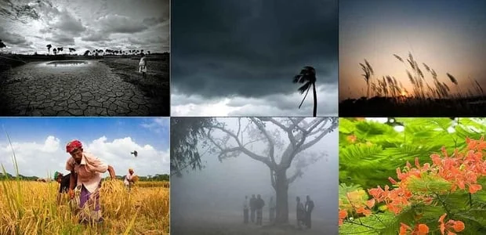
SIX SEASONS OF BANGLADESH
A GREAT HUB OF DIVERSITY

Slide 3
INTRODUCTION:
Bangladesh, located at the intersection of the Indo-Himalayan and Indo-Chinese sub-region, is subjected to various seasons. After every two months, there’s a change in seasons. Seasons are classified based on the type of weather in a particular area. Bangladesh is known as the “Land of six seasons”.
The six seasons of Bangladesh are mainly:
1. Summer (Grisma ritu),
2.Rainy (Barsa ritu),
3.Autumn (Sarat ritu),
4.Late Autumn (Hemanta ritu),
5.Winter (Shitt ritu)
6. Spring (Basant ritu).
Some seasons may extend more than 2 months, while others may be less than 2 months.
Hence, nowadays, the seasons in Bangladesh are mainly Pre-monsoon hot season, rainy monsoon season and cold winter season but the importance of all these 6 seasons is still relevant.Let us discuss all the seasons with their importance in people’s lives as well as the economy of Bangladesh.

Slide 4
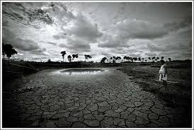
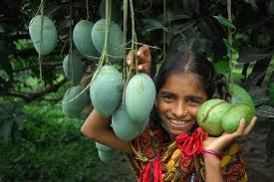
1. Summer

Slide 5


2.Rainy Season

Slide 6
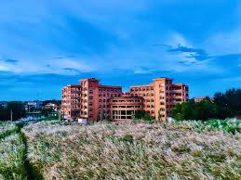
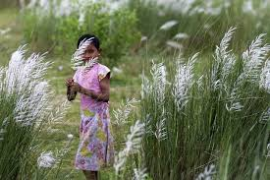
3.Autumn

Slide 7
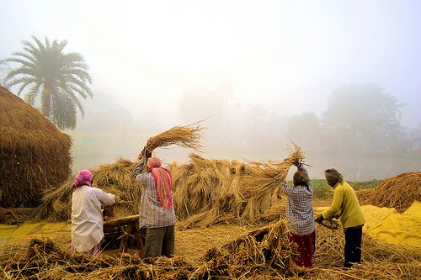
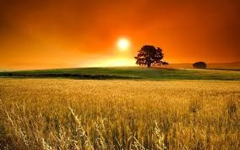
4.Late Autumn

Slide 8
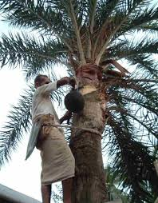
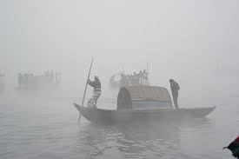
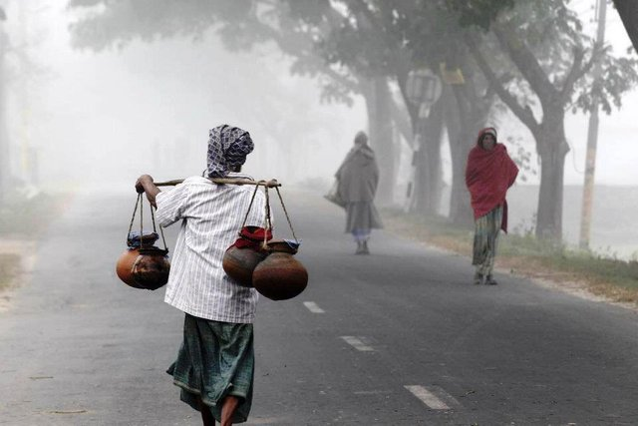
5.Winter

Slide 9
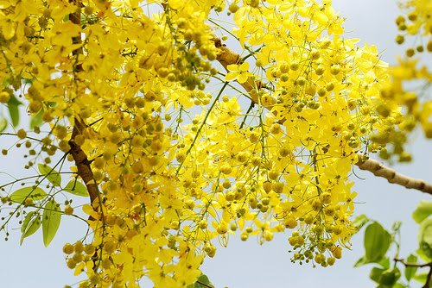
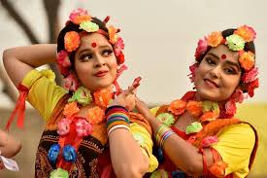
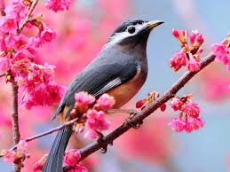
6.Spring

Slide 10
THE END THANK YOU

